Slide 1
Aws inspector
ow

Slide 2
overview
AWS Inspector is a vulnerability scanning service by AWS that is used to scan your EC2 instances, container images, and Lambda functions.
Its findings will report vulnerabilities known as CVE’s (Common Vulnerabilities and Exposure) which are computer security flaws that are made public with the intention of bringing awareness and transparency.
If your AWS environment has multiple accounts, you can centrally manage your environment through a single account by using AWS Organizations. Using this approach, you can designate an account as the delegated administrator account for Amazon Inspector.

Slide 3
CVE
The US Government maintains a database of vulnerabilities with data such as risk score, product name, references, remediation and more. This database is known as the National Vulnerability Database(NVD) and is the source for many companies when trying to understand the impact of each vulnerability. Amazon Inspector uses the NVD score in many of its vulnerabilities.
A CVE naming convention will normally start with CVE followed by the year the vulnerability was discovered and then followed by a unique order number. Additionally, a profile of the vulnerability such as the severity, and in some cases how to “remediate” is updated frequently to keep users informed.

Slide 4
Scan types
Amazon EC2 scanning :This scan type extracts metadata from your EC2 instance before comparing the metadata against rules collected from security advisories. When you activate this scan type, Amazon Inspector scans all eligible instances in your account for package vulnerabilities and network reachability issues.
Amazon ECR scanning :This scan type scans container images in Amazon ECR. When you activate this scan type, you change the scanning configuration setting for your private registry from basic scanning to enhanced scanning

Slide 5
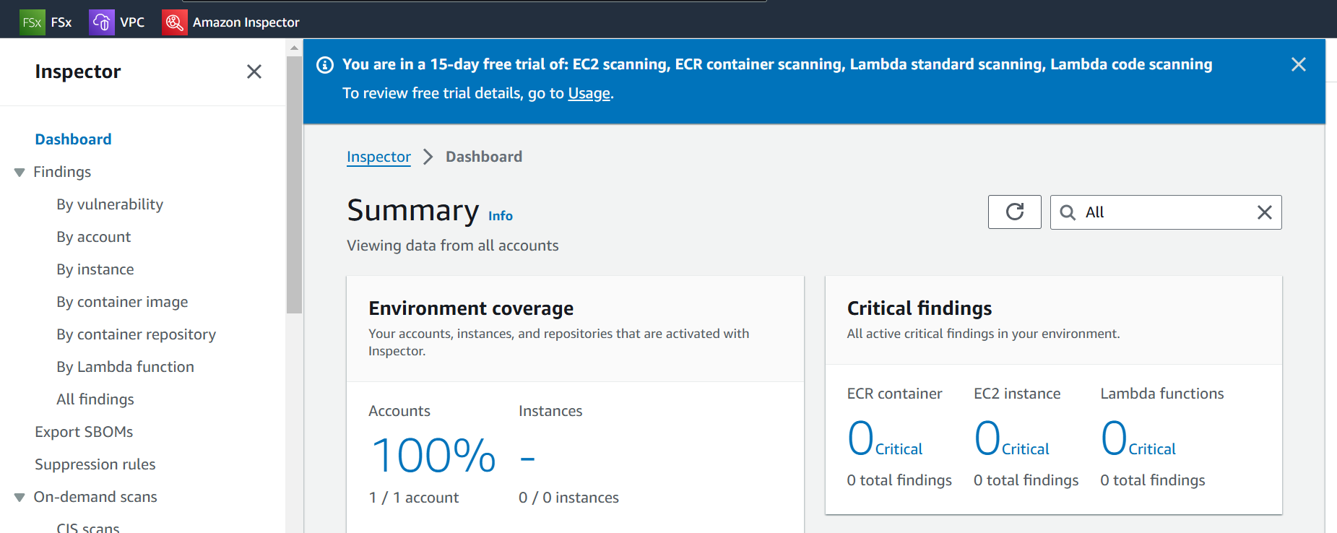
Dashboard

Slide 6
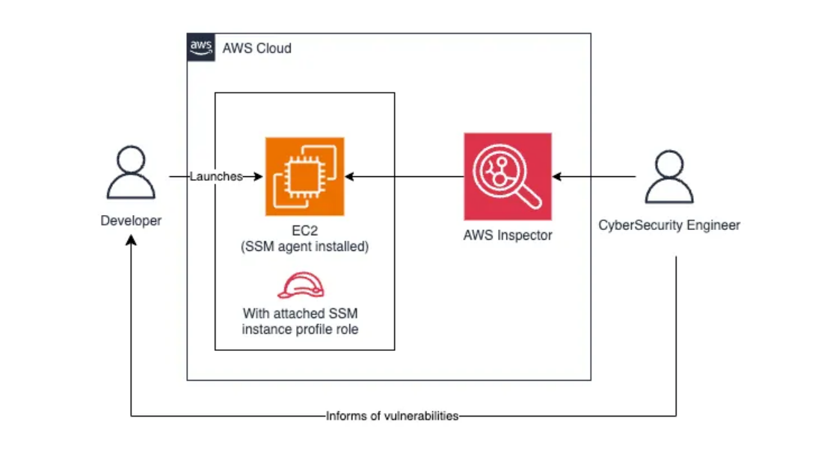
Ec2 scan

Slide 7
.
At a high level, AWS Inspector is dependent on an agent to be installed in the EC2 instance that will be used to scan and report the security findings.
Additionally, the EC2 will need a role that grants SSM to reach the EC2 instance.
AWS Inspector uses the SSM agent to connect to the instance
AWS Inspector can be supported at the organizational level and scan all accounts in the organization; however, the scope of this blog will be a single account.

Slide 8
EC2 instance scanning
Create a SSM role
Setup aws ec2 instance (aws linux)
Login to aws instance and check
Check the inspector dashboard
Update the role
Again check the Report

Slide 9
Lab to activate inspector
Lab 1: Activate the inspector
Lab 2: Enable the vulnerability scan

Slide 10
Use cases
A three-tier application consists of three layers:
presentation (web server)
application (business logic)
database (data storage)
AWS Inspector can play a critical role in monitoring the web server tier for vulnerabilities and misconfigurations. Here's an example scenario:

Slide 11
..
Presentation Layer (Web Server):
Amazon EC2 instances running NGINX or Apache as the web server.
Serves static and dynamic content to end users.
Application Layer:
EC2 instances or containerized microservices running application logic.
Interacts with the database and processes business logic.
Database Layer:
Amazon RDS or self-managed database on EC2 instances.
Stores application data securely.

Slide 12
SBOM Generator
A Software Bill of Materials (SBOM) is a formally structured list of components, libraries, and modules required to build a piece of software.
The Amazon Inspector SBOM Generator (Sbomgen) is a tool that produces an SBOM for archives, container images, directories, local systems, and compiled Go and Rust binaries.
Sbomgen scans for files that contain information about installed packages. When Sbomgen finds a relevant file, it extracts package names, versions, and other metadata.
Sbomgen then transforms package metadata into a CycloneDX SBOM. You can use Sbomgen to generate the CycloneDX SBOM as a file or in STDOUT and send SBOMs to Amazon Inspector for vulnerability detection.

Slide 13
..
Enable Inspector
Attach the AWS Inspector agent to all EC2 instances hosting the web servers.
Define an Inspector Assessment
Assessment Targets:
Target all EC2 instances tagged with Environment: Production and Tier: WebServer.
Assessment Templates:
Include rules for:
Common vulnerabilities and exposures (CVEs).
Misconfigurations in the operating system and web server software.
Compliance standards like CIS Benchmarks.
Integrate Inspector with CI/CD Pipeline
After deploying a new web server AMI or updates, trigger an Inspector scan to validate the security posture.

Slide 14
workflow
Deployment:
A new EC2 instance is provisioned with an NGINX web server as part of the CI/CD pipeline.
The pipeline triggers an Inspector scan after the server is configured.
Assessment:
Inspector scans the EC2 instance for:
Vulnerabilities in the NGINX version (e.g., CVE-2023-XXXX).
Unnecessary open ports (e.g., Port 22 left open to all).
Outdated or misconfigured OS components.

Slide 15
..
Findings:
Inspector identifies:
A critical CVE in the deployed NGINX version.
The web server is running with default configurations, exposing unnecessary headers.
Remediation:
Update the NGINX version to a secure release.
Apply recommended configurations to the web server (e.g., disabling unnecessary modules).
Post-Remediation Scan:
Run another Inspector scan to validate that the vulnerabilities have been resolved.

